Slide 1
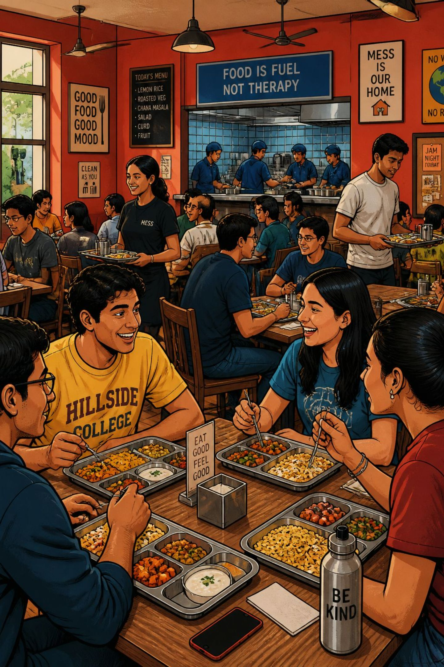
Community Engagement Project (CEP)
Nutrition and Hygiene Maintenance: A Study on Food Waste Management in Hostel Mess
Presented by:
1.SANIKA TAVATE 25UAM128
2.PRACHI MAJLEKAR 25UAM118
3.GAYATRI SANKPAL 25UAM142
4.SHREYA BHOSALE 25UAM140
5.RUTUJA DHOLE 25UAM079
6.RUKAIYYA SHAIKH 25UAM127
DEPARTMENT : Computer Science & Engineering (AI & ML) — DKTE Society's Textile & Engineering Institute
Take only what you need, because every grain of food carries someone's hard work !!!!!!!!

Slide 2

Introduction
Food waste in hostel messes affects nutrition, hygiene, operational cost, and the environment. This study documents how and why edible food is discarded, inspects hygiene practices, and explores practical interventions that reduce waste while preserving meal quality for students.

Slide 3

Problem Statement & Objectives
Problem
Objectives
Excess edible food is wasted daily; poor disposal harms hygiene and increases costs. Lack of awareness and inconsistent portioning are key drivers.
Identify causes of food waste
Assess hygiene & sanitation
Analyze waste management practices
Recommend sustainable, actionable solutions

Slide 4

Staff Interviews
Documentation
Observation
Surveys
Our mixed-methods approach combines qualitative observation with structured surveys and staff interviews, supported by photographic documentation (with permission) to produce practical, evidence-based recommendations.

Slide 5
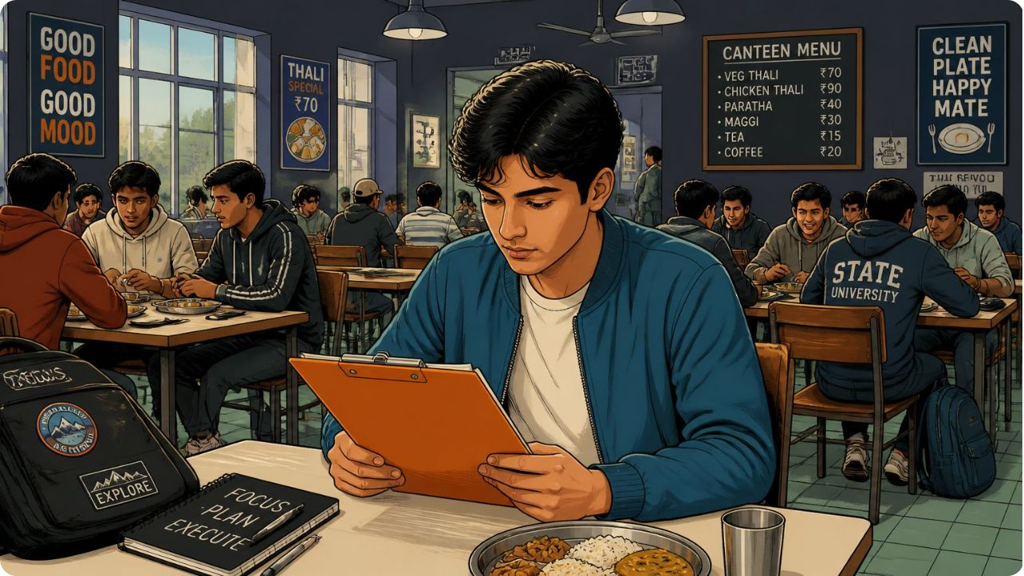


Survey & Observation
We asked targeted questions to both students and mess staff to capture behavior, motivations, and operational realities.
Student Questions
Staff Questions
Do you finish meals? Reasons for wasting food? Support for half-portion options? Suggestions to reduce waste?
Estimated daily waste, leftover handling, hygiene routines, operational challenges and constraints.

Slide 6

Hygiene & Waste Observations
Key observations: inconsistent serving hygiene, occasional uncovered leftovers, variable handwashing adherence, and gaps in segregation of wet and dry waste. These issues increase contamination risk and complicate composting or donation efforts.

Slide 7
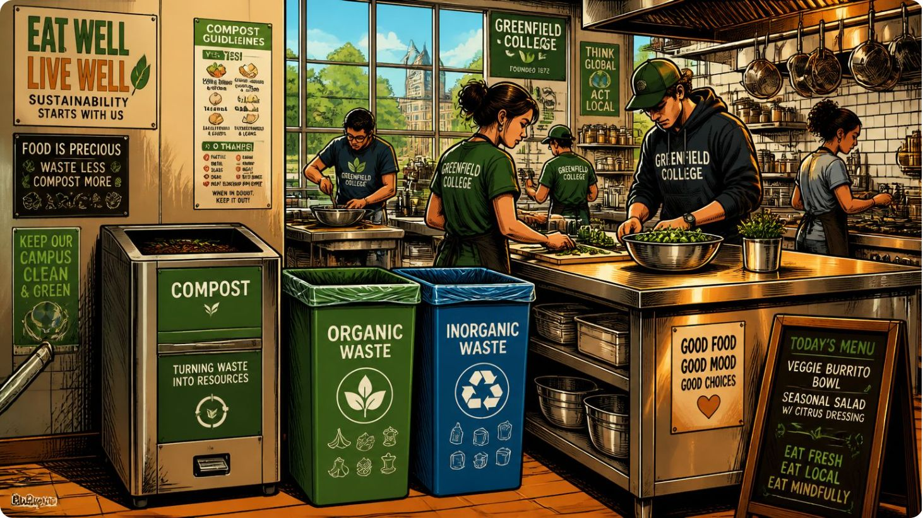

Expected Outcomes
Pinpoint primary causes of food wastage and peak waste times
Map student eating patterns and portion preferences
Evaluate current hygiene and waste-handling practices
Produce prioritized, practical recommendations for the mess
Outcomes will guide pilot interventions and an evaluation plan for scaled adoption.

Slide 8





Project Contribution to SDGs
SDG 2 — Zero Hunger
Reduce edible food waste to increase availability and food security within the community.
SDG 3 — Good Health
Improve nutrition and sanitation through safer handling and portion control.
SDG 12 — Responsible Consumption
Encourage mindful consumption, composting, and better menu planning.
SDG 13 — Climate Action
Reducing food waste lowers methane emissions and supports campus sustainability goals.

Slide 9
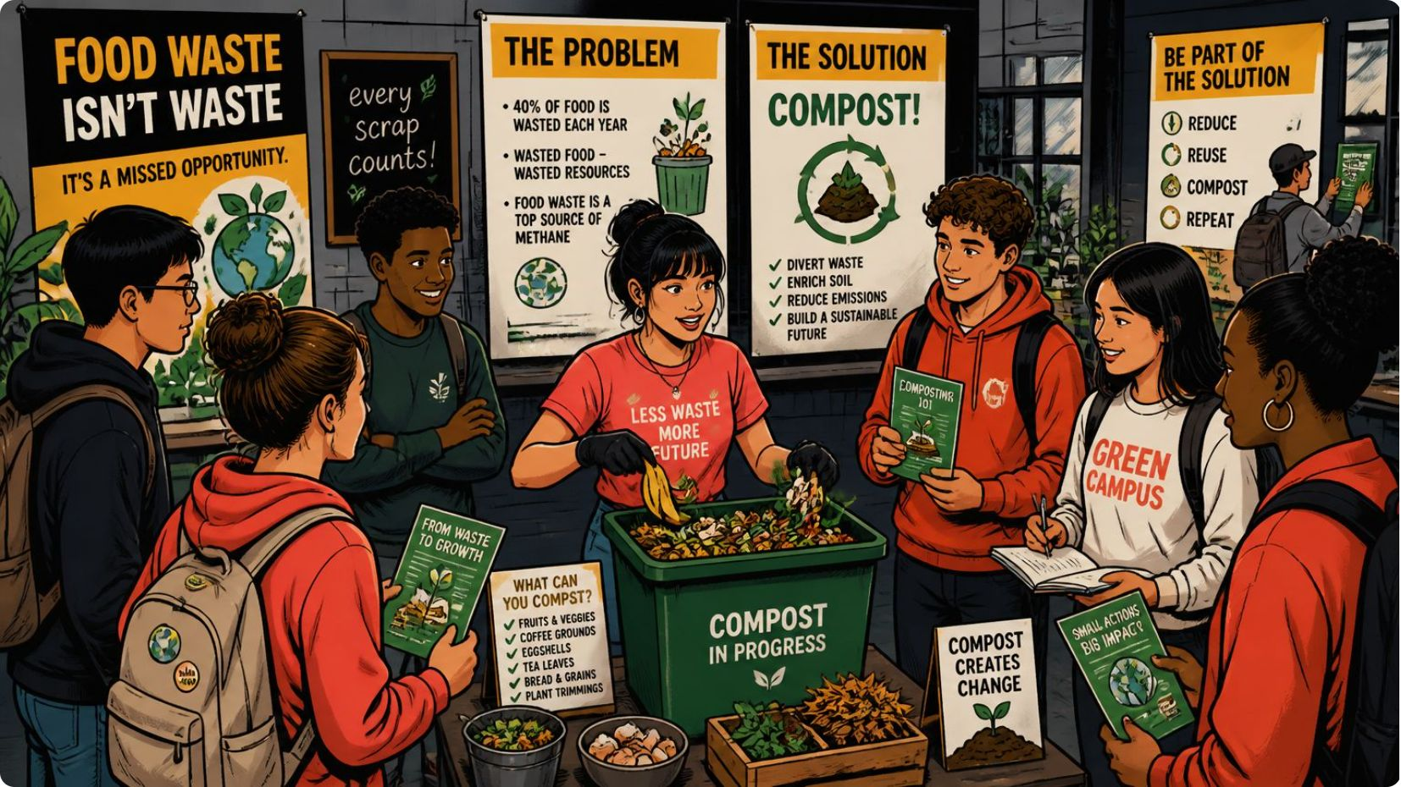
Recommendations
Portioning Options
Awareness Campaigns
Introduce standard and half-portion choices; monitor uptake to adjust quantities.
Student-led workshops, posters, and social media prompts on minimizing waste and hygiene best practices.
Composting & Segregation
Donation Protocol
Safe surplus food donation procedures, partner with local NGOs, and strict hygiene checks.
Set up clearly labeled bins and a small on-site composting system for unavoidable organic waste.
Menu Optimization
Use survey feedback to refine menus, reduce unpopular dishes, and align preparation volumes with demand.

Slide 10
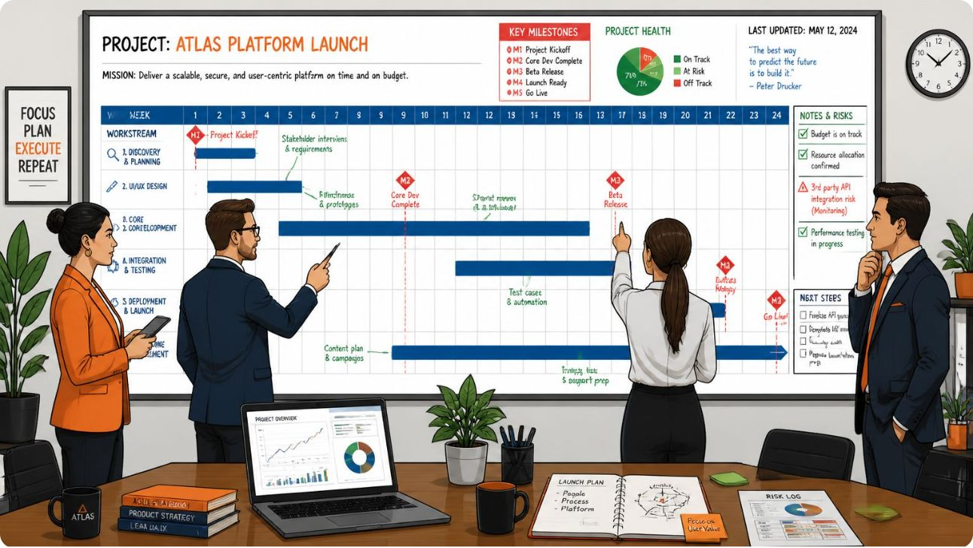
Project Timeline & Conclusion
Timeline (16 weeks):
Week 1 -4— Topic selection, literature review, and planning
Week 5-8 — Questionnaire creation, site permissions, first site visit
Week 9-12 — Surveys, staff interviews, and data analysis
Week 12-16 — Compile report, recommendations, and final presentation
Conclusion: Small operational changes, combined with student engagement and improved hygiene, can significantly reduce food waste in hostel messes. Every saved portion improves nutrition, lowers costs, and reduces environmental impact.
"Every grain saved is a step toward a healthier community and a sustainable future."
THANK-YOU

